Slide 1
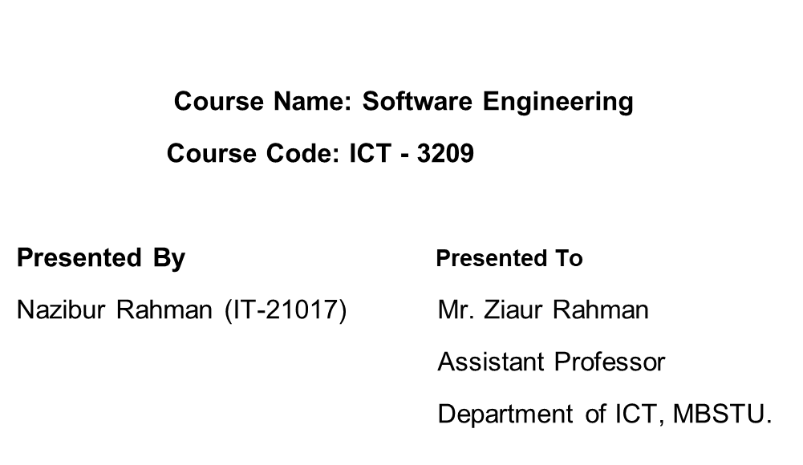
“Extreme Programming”

Slide 2
Overview
Introduction
Objective
Core Principles
Application
Life Cycle
Advantages
Challenges
Conclusion
Q/A

Slide 3
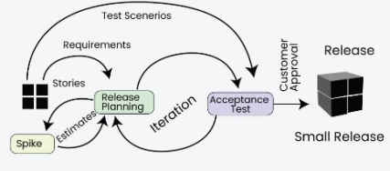
Introduction
Extreme Programming (XP) is an Agile software development methodology that focuses on delivering high-quality software through frequent and continuousfeedback, collaboration, and adaptation. XP emphasizes a close working relationship between the development team, the customer, and stakeholders, with an emphasis on rapid, iterative development and deployment.

Slide 4
Objective of Extreme Programming
Improve Software Quality
Increase Developer Productivity
Adapt to Changing Requirements
Enhance Customer Satisfaction
Reduce Project Risks
Simplify Software Development

Slide 5
Core Principles of Extreme Programming
Communication: Emphasizes constant and transparent communication among team members and stakeholders.
Simplicity: Focus on the simplest solution that works, avoiding unnecessary complexity.
Feedback: Continuous feedback from clients, team members, and testing to refine and improve the product.
Courage: Encourages teams to make tough decisions, such as refactoring code or revisiting requirements.
Respect: Fosters mutual respect among all team members to ensure a collaborative and supportive environment.

Slide 6
Application of Extreme Programming
Agile Development: Adapts quickly to changing requirements.
Pair Programming: Enhances code quality and teamwork.
Test-Driven Development: Ensures functionality through automated tests.
Frequent Releases: Delivers incremental updates for feedback.
Continuous Integration: Reduces integration issues with frequent updates.
On-Site Customer: Ensures clear and prioritized requirements.
Refactoring: Maintains simplicity and scalability.
Sustainable Pace: Promotes long-term productivity.

Slide 7
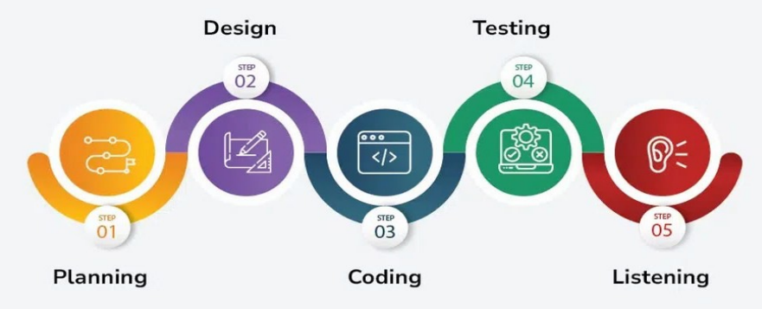
Life Cycle of Extreme Programming

Slide 8
Advantages of Extreme Programming
High-Quality Code: Continuous testing and refactoring ensure robust and maintainable code.
Faster Delivery: Frequent releases and iterations enable quicker deployment of functional software.
Flexibility: Easily adapts to changing customer requirements.
Improved Collaboration: Promotes strong communication among team members and with customers.
Reduced Risks: Early detection of issues through constant feedback and testing.
Customer Satisfaction: Regular involvement ensures the product meets client expectations.
Knowledge Sharing: Pair programming fosters learning and skill development within the team.
Balanced Workload: Sustainable pace prevents burnout and ensures steady progress.

Slide 9
Challenges of Extreme Programming
High-Quality Code: Continuous testing and refactoring ensure robust and maintainable code.
Faster Delivery: Frequent releases and iterations enable quicker deployment of functional software.
Flexibility: Easily adapts to changing customer requirements.
Improved Collaboration: Promotes strong communication among team members and with customers.
Reduced Risks: Early detection of issues through constant feedback and testing.
Customer Satisfaction: Regular involvement ensures the product meets client expectations.
Knowledge Sharing: Pair programming fosters learning and skill development within the team.

Slide 10
Conclusion
Extreme Programming (XP) is a flexible and customer-focused approach to software development.
By emphasizing collaboration, continuous improvement, and frequent feedback, it delivers high-quality software that meets evolving requirements.
While it has challenges, such as requiring discipline and customer involvement, its advantages make it ideal for dynamic and fast-paced projects.
XP promotes a balance between technical excellence and team productivity, making it a valuable methodology in modern software engineering.

Slide 11
Q/A
Thank the Audience and open the floor for questions.

Slide 12
Thank You

